Slide 1


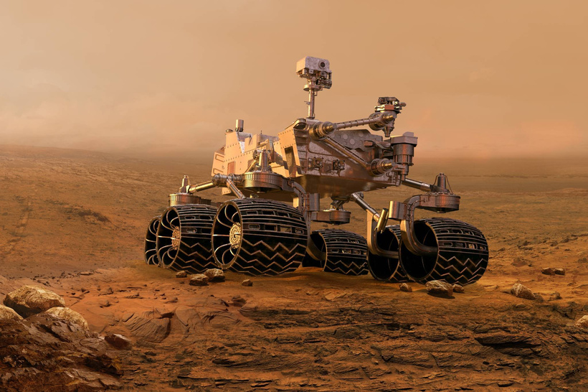
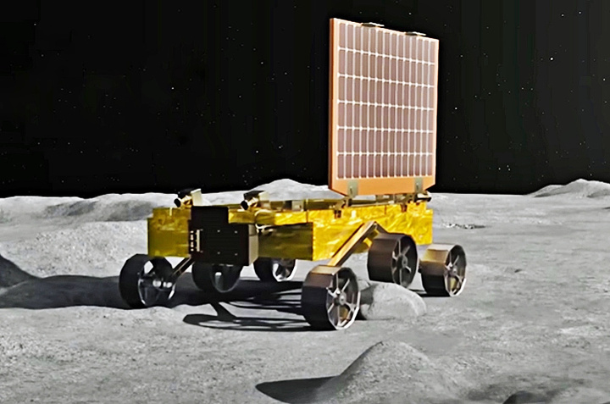
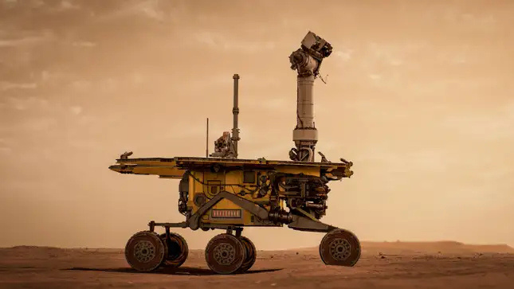
AAVISHKAR
NAVI-LINK
Category- Engg & Tech
Level- UG
Code - 5174
DEVELOPING ADVANCED LINKAGE SUSPENSION SYSTEM FOR ROVER
PERSEVERANCE
NASA-2020
PRAGYAN
ISRO-2023
OPPORTUNITY
NASA-2018

Slide 2

WHAT IS THE NEED OF NAVI-LINK?
Navigating challenging and unpredictable terrains
Overcoming limitations of traditional suspension systems
Ensuring stability on slopes and obstacles
Achieving independent wheel movement for better mobility
Minimizing mechanical stress and vibration impact
PAGE 01

Slide 3

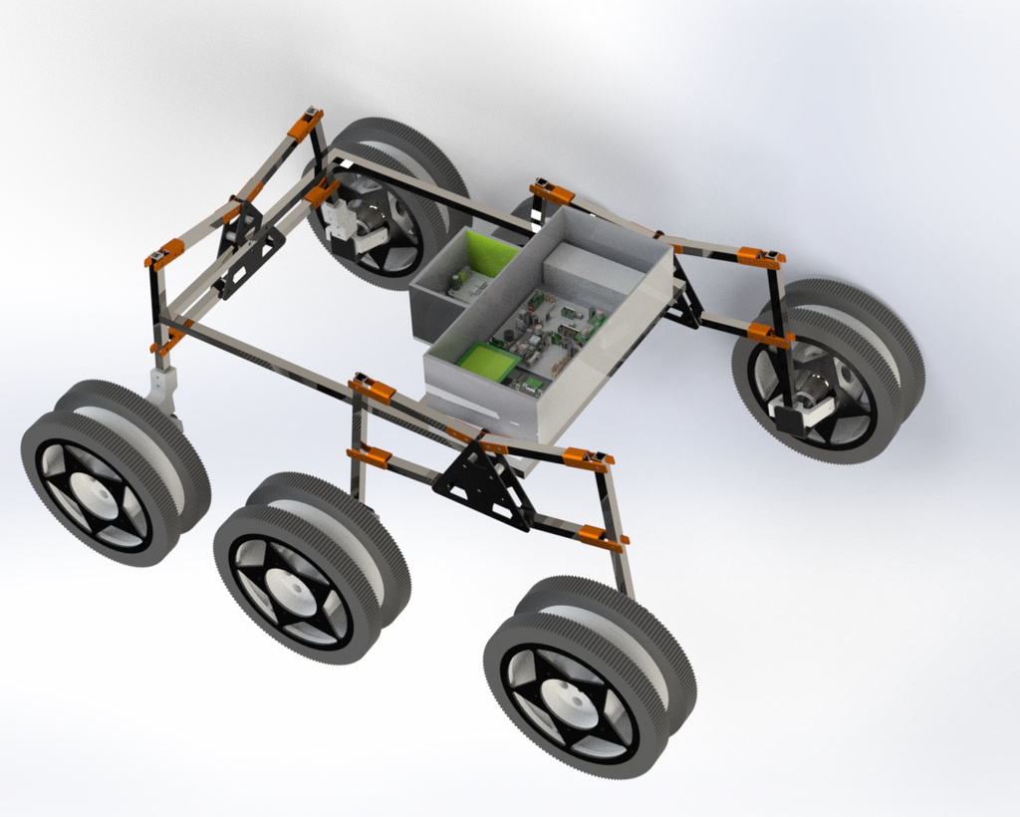
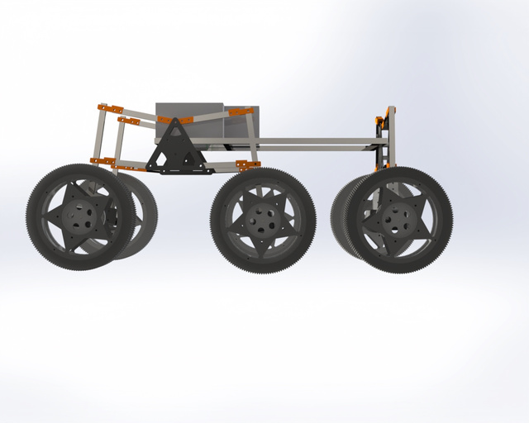
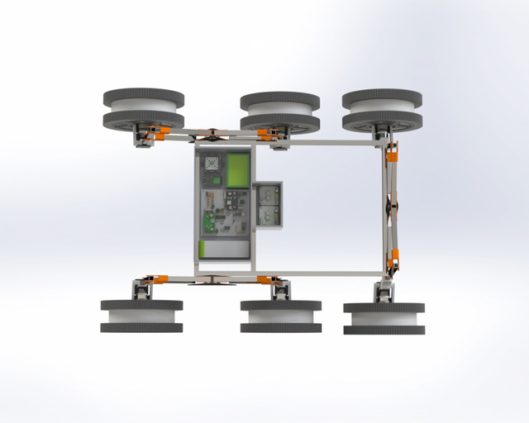
DESIGN OF NAVI-LINK
NAVI-LINK FEATURES A UNIQUE SUSPENSION SYSTEM , WHICH PROVIDES BETTER
STABILITY AND CONTROL OF THE LOAD IN HIGH SPEED CONDITIONS ,
PROVIDES EASIER CONTROL AND TRACTION WITH BETTER SLOPE HANDLING
CAPACITY.
PAGE 02

Slide 4

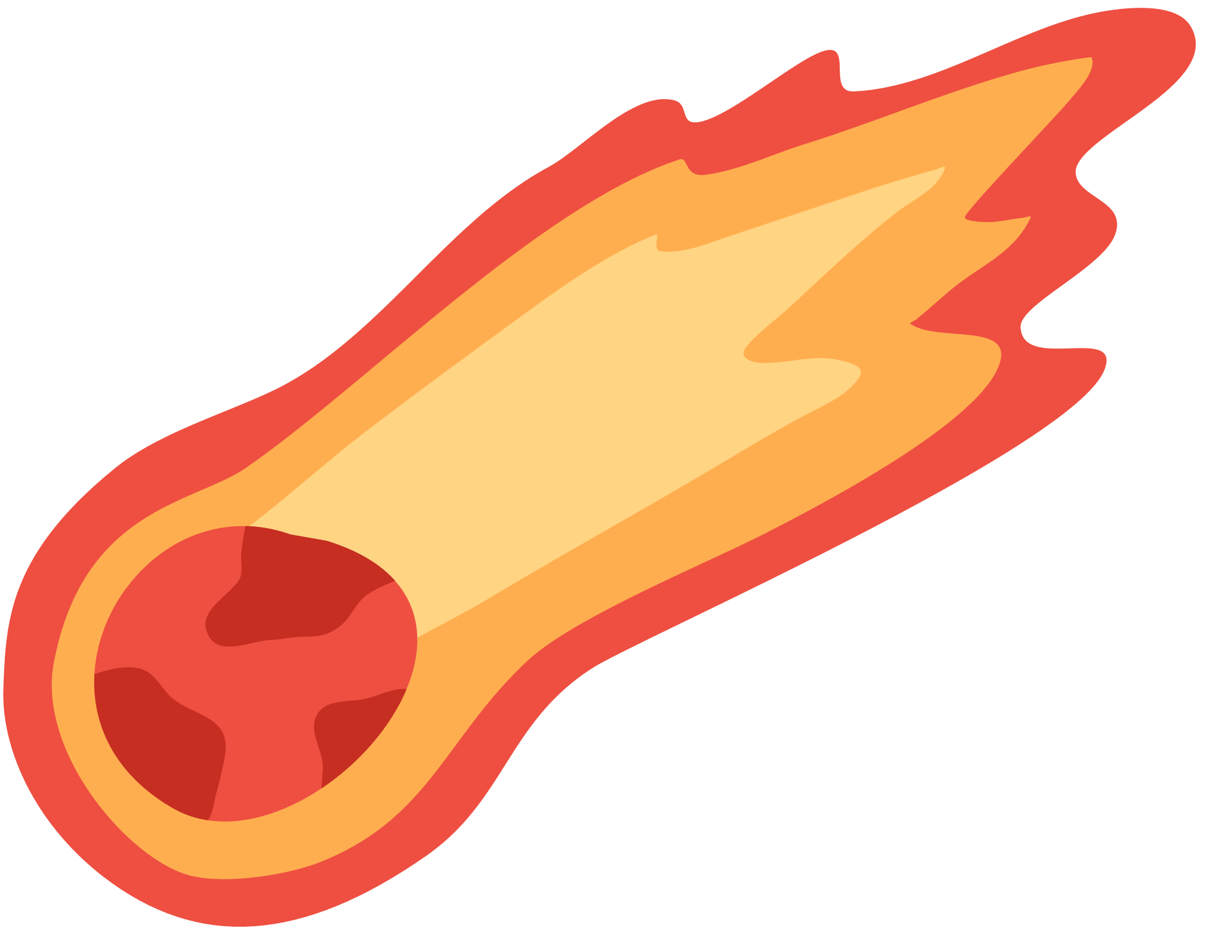



PROJECT DESCRIPTION
01.
Independent Wheel Movement: Each wheel can articulate independently to maintain continuous ground contact.
02.
Enhanced Stability: The double linkage improves balance on uneven terrains and steep slopes.
The Double Lambda Linkage Suspension is an advanced design featuring two interconnected triangular (A-frame) linkages on each side of the rover. This configuration provides:
03.
Superior Load Distribution: It evenly spreads weight, reducing mechanical stress on the frame and instruments.
04.
Adaptability: The system handles multi-directional obstacles, offering better performance than conventional suspensions (like rocker-bogie).
PAGE 03

Slide 5


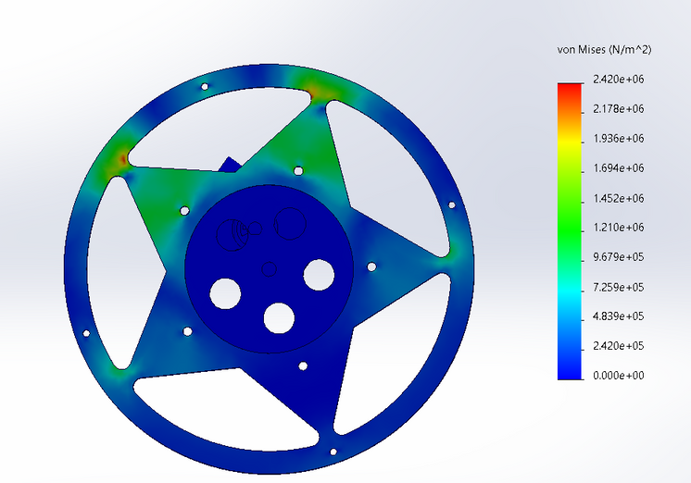
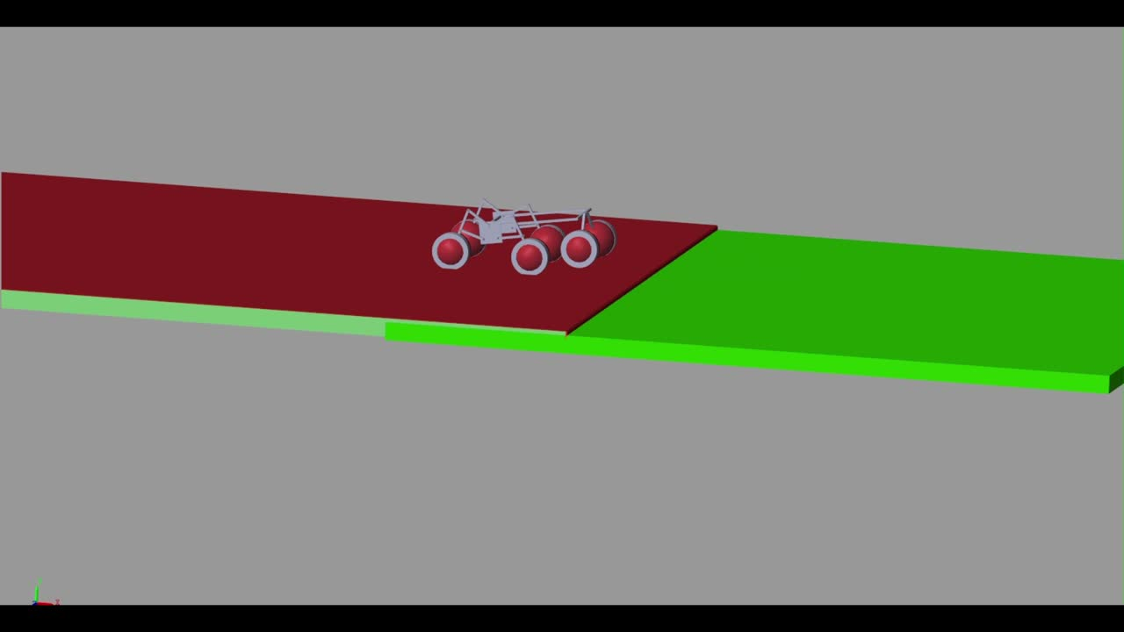


ANALYSIS AND SIMULATIONS
CONSIDERING THE WHEELS BEING THE MOST IMPORTANT PART OF THE SYSTEM , ITS STRESS ANALYSIS UNDER DIFFERENT LOADS WAS STUDIED USING FEA
SIMULATING REAL LIFE ENVIRONMENT USING MATLAB SIMULINK TOOL HELPED IN CHANGING THE PARAMETERS IF THE ROVER SUSPENSION
PAGE 04

Slide 6

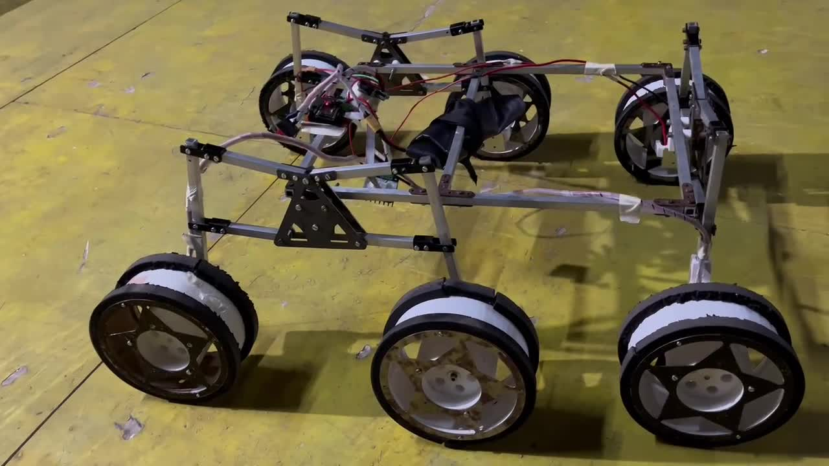
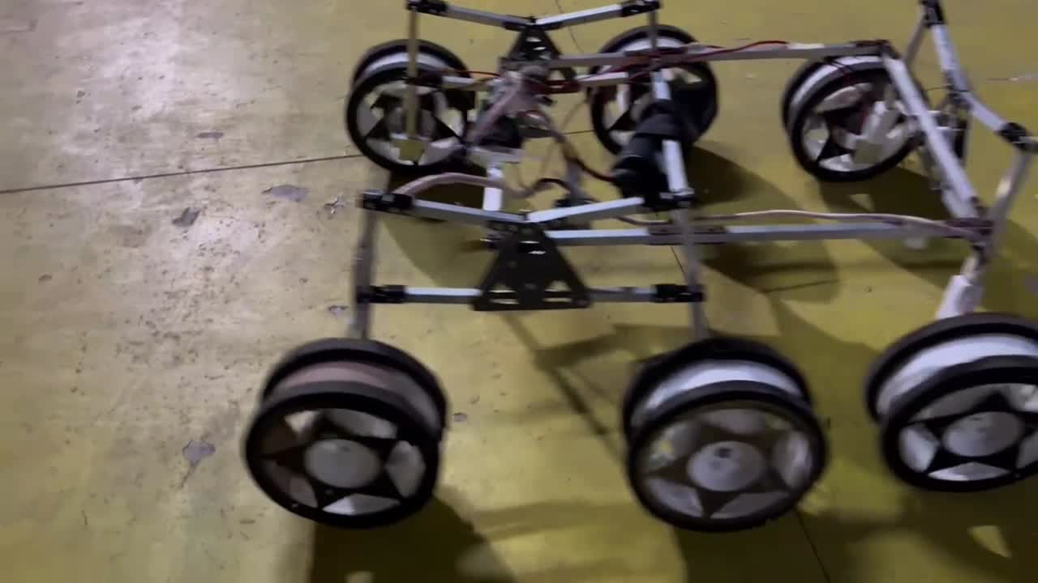
Controlled Environment
RAMP TEST
OBSTACLE TEST
PAGE 05

Slide 7
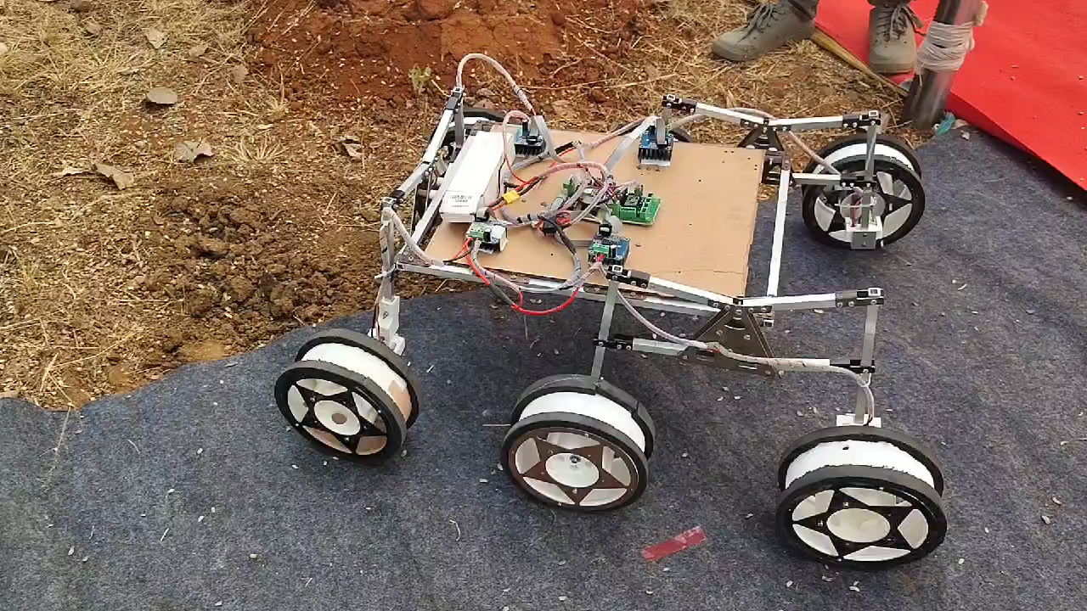
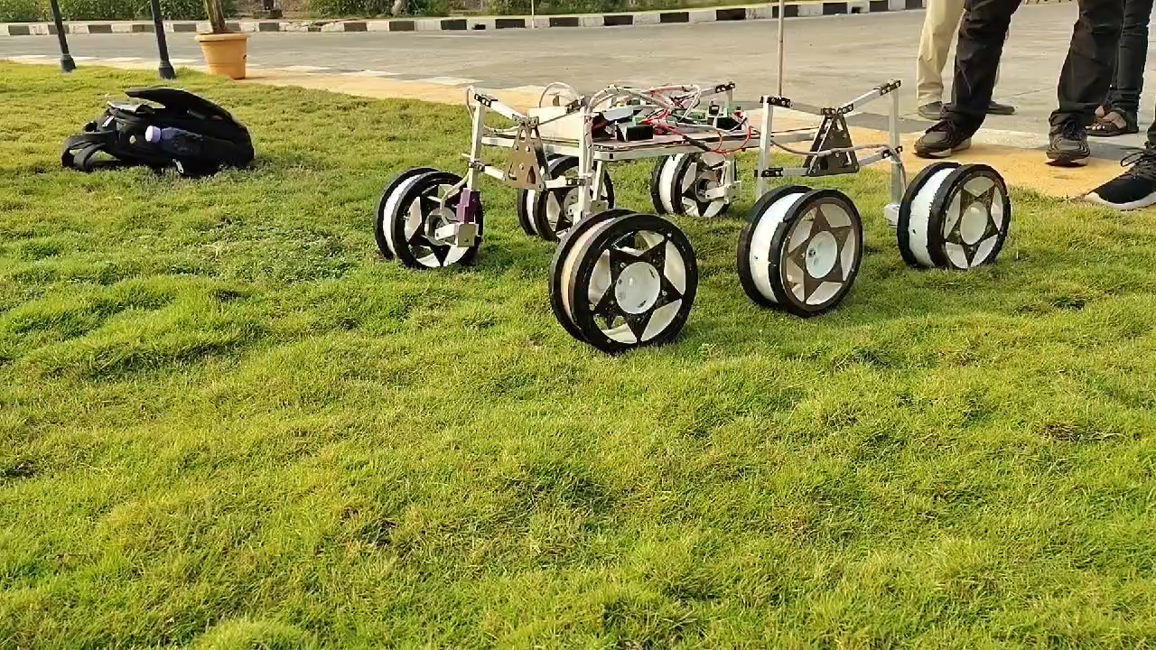
Real life conditions
Rough terrain test
Date – 13/01/2025
Grass/moist terrain test
Date – 14/01/2025
PAGE 06

Slide 8
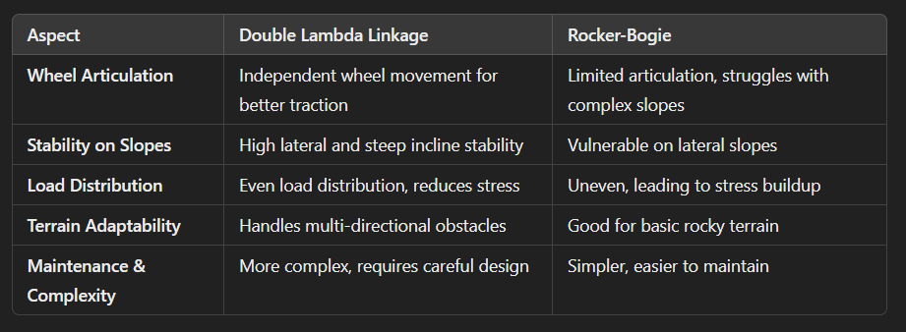
COMPARITIVE ANALYSIS
PAGE 07

Slide 9
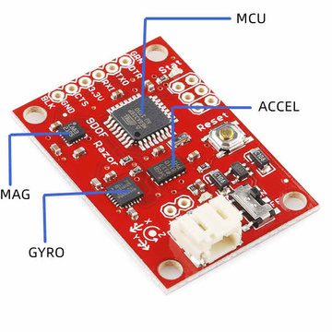
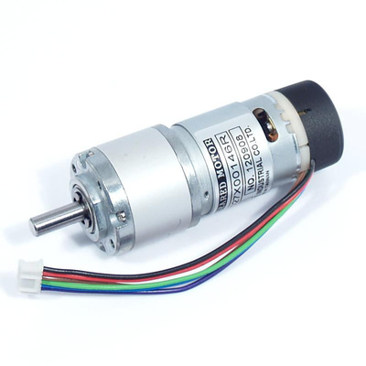
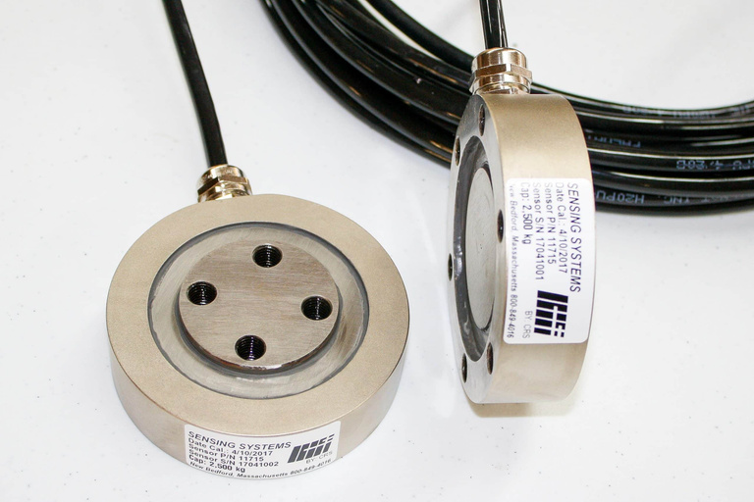
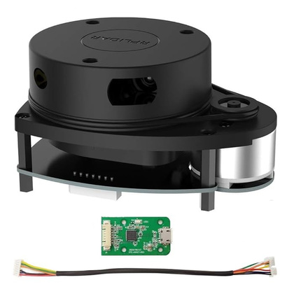
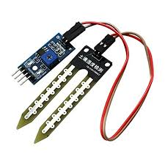
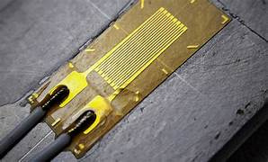
ELECTRONICS AND SENSORS
IMU - INERTIAL MEASUREMENT UNIT
WHEEL MOTORS WITH ENCODERS
LOAD/FORCE SENSORS
LI-DAR SENSOR
(NAVIGATION)
Moisture
Sensor
PRESSURE /STRAIN
SENSOR
PAGE 08

Slide 10
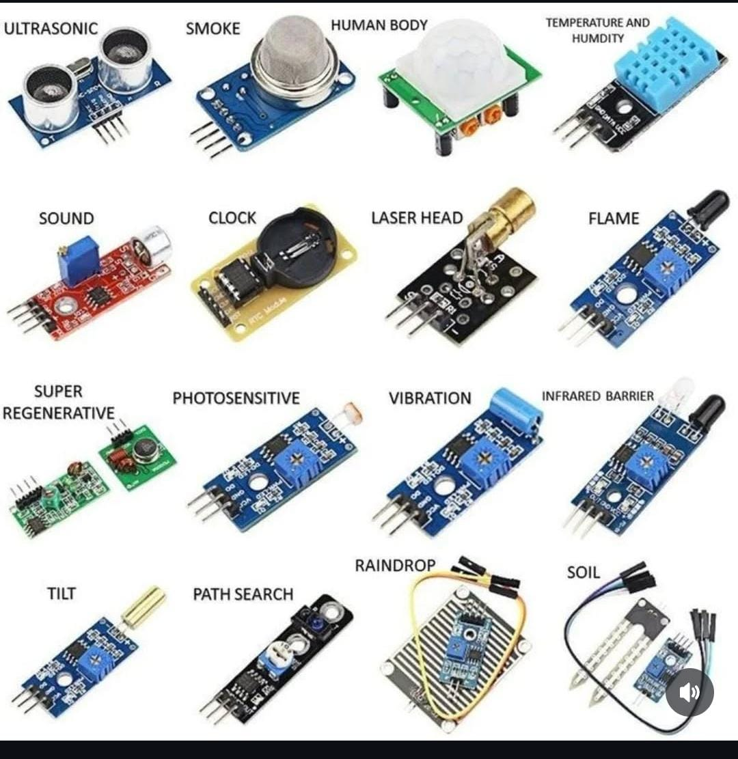
Support for Peripherals
PAGE 09

Slide 11
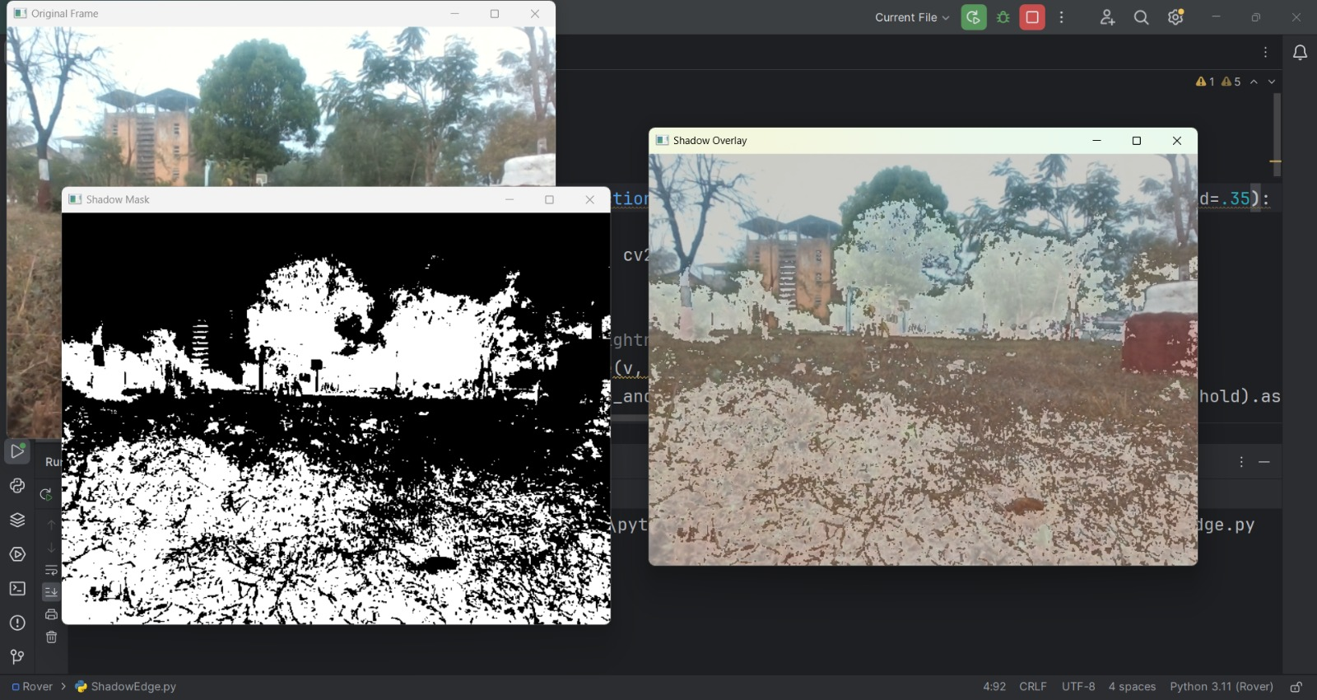
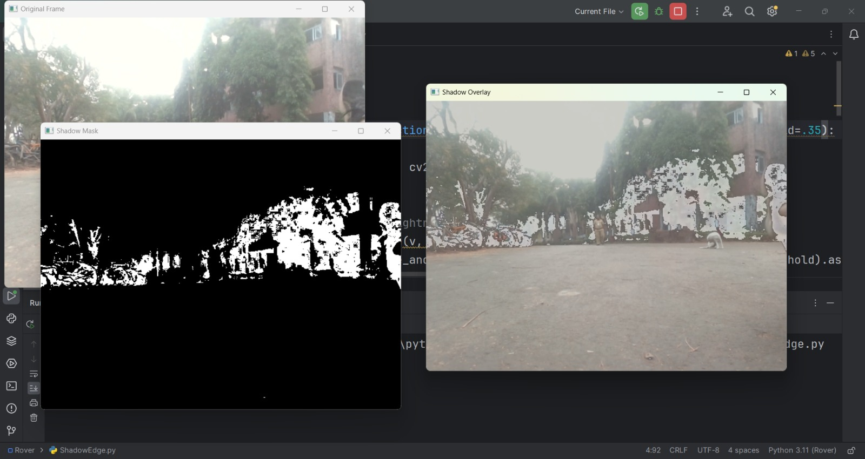
Integrating with Computer Vision
Path Planning
Rough Surface
Smooth Road
PAGE 10

Slide 12
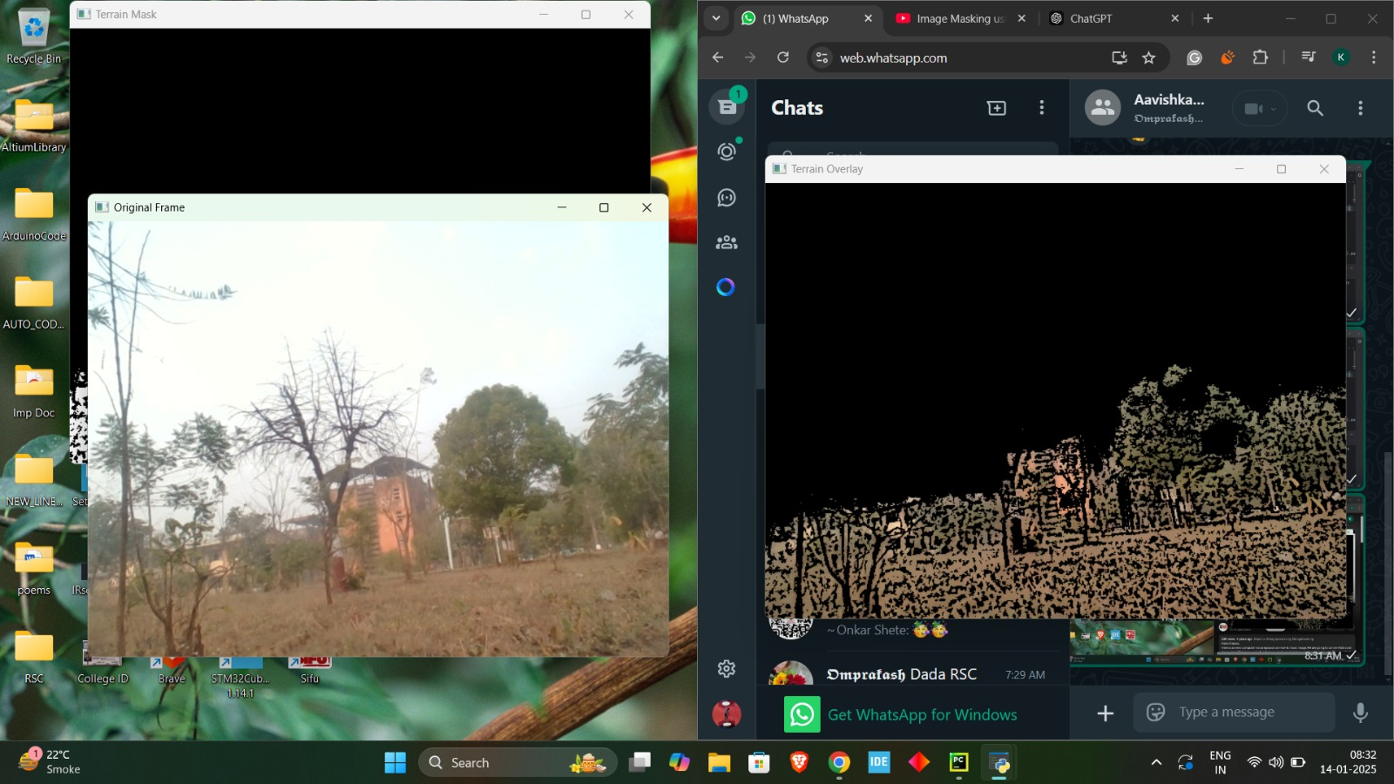
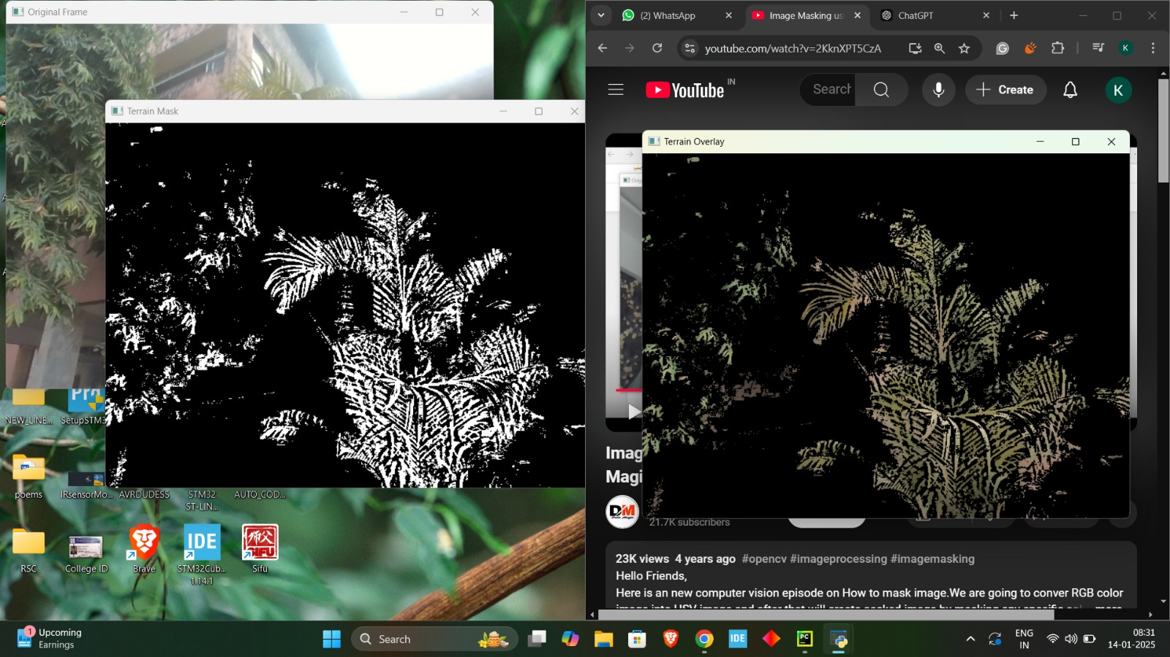
Integrating with Computer Vision
Terrain Detection
PAGE 11

Slide 13
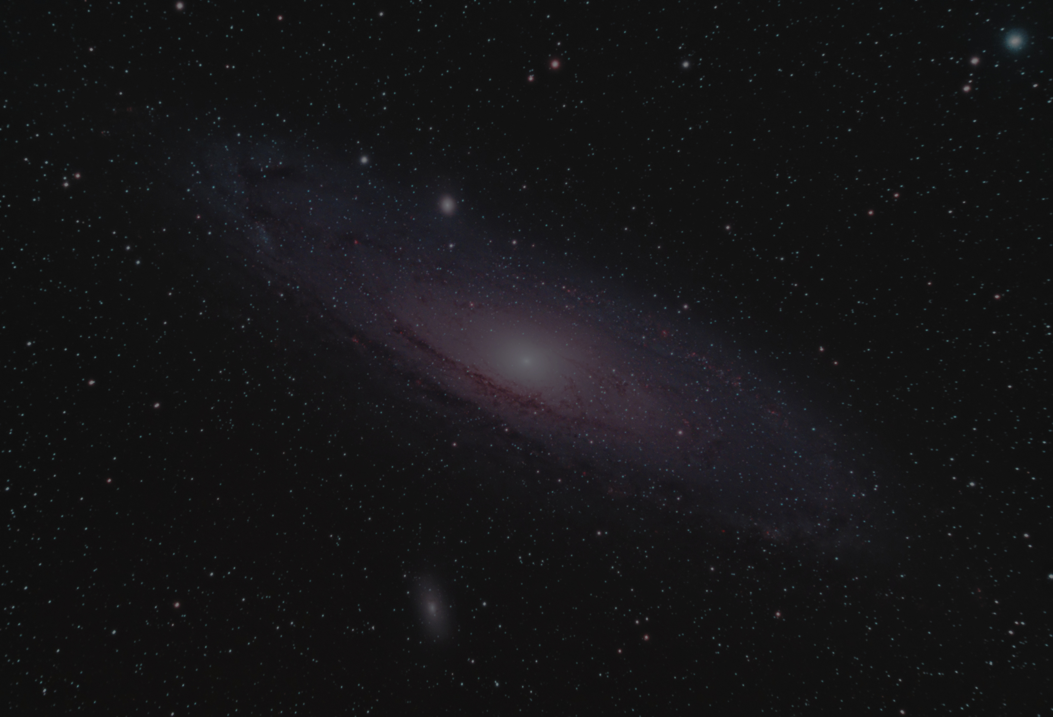
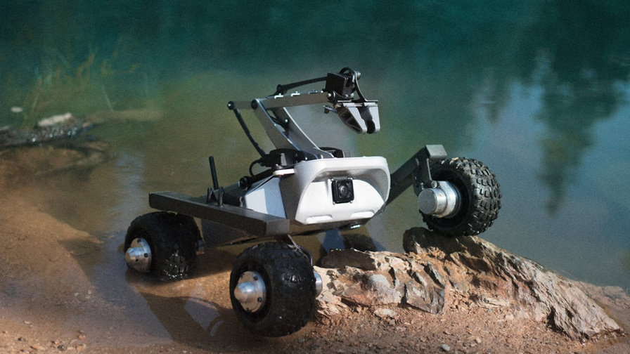
APPLICATIONS
PLANETARY ROVERS (MARS, MOON EXPLORATION)
Search-and-rescue robots
Off-road autonomous vehicles (agriculture, mining, forestry)
CONCLUSION
SUPERIOR STABILITY AND LOAD MANAGEMENT
ENHANCED TERRAIN ADAPTABILITY
VALUABLE FOR CURRENT AND FUTURE EXPLORATION CHALLENGES
PAGE 12

Slide 14

ENTREPRENEURSHIP
LOW COST OF PRODUCTION: Developed with low-cost materials
REPEATABILITY: Same linkage mechanism can be used on all 3 sides
EASY TO DEPLOY: The rover can be Modularized
CHEAP PCB DESIGN: In house manufacturing
SUPPORT FOR PERIPHERALS: Various sensor attachments available
PAGE 13

Slide 15

THANK
YOU !

